Slide 1

SUICIDE RATE AND PREDICTION ANALASYIS USING MACHINE LEARNING
Paras gumber - 12020853
Gaurav kumar – 12017195
INT 254 fundamentals of machine learning

Slide 2
INTRODUCTION
Suicide is a growing public health concern in the entire world.
The World Health Organization (WHO) estimates that every year close to 800k people take their own life, which is one person every 40 seconds and there are many more people who attempt suicide.
The objective of this project is to predict the suicide rates using Machine Learning algorithms and to analyzing significant patterns features that result in increase of suicide rates globally.
This project is done in Jupyter Notebook.

Slide 3
UTILITY
While it is impossible to completely eliminate suicide, it should be possible to improve prediction and prevention through better analytical tools. People with suicidal thoughts also feel afraid to discuss these thoughts with friends and family because of fear they might be judged, hospitalized or medicated.
Population-wide suicide prediction is likely to offer an ethical and useful application of AI, aiding policy makers and medical professionals in better allocating healthcare resources.
Improve predictions and prevention through better analytical tools. Recent studies suggest that ML methods to electronic health records can improve patients and ability to identify patient at high risk of suicide.

Slide 4
DATASET DETAILS
The dataset is from Kaggle. This is a compiled dataset pulled from four other datasets linked by time and place from year 1985 to 2016.
The source of those datasets is WHO, World Bank, UNDP and a dataset published in Kaggle.
It has 27820 samples and 12 features.
The features in the dataset are:
– country, year,sex, age group, country-year, generation (based on age grouping average).
– count of suicides, population,suicide rate, HDI for year, gdp_for_year, gdp_per_capita.
The number of countries in the data set are 101.

Slide 5
The age of person is categorized into 6 age groups.
75+ years
55-74 years
25-34 years
35-54 years
15-24 years
5-14 years
Generation is categorized into 6 groups.
Generation X
Silent
Millennials
Boomer
G.I Generation
Generation Z

Slide 6
METHODS
DATA LOADING
UNDERSTANDING DATA
VISUALIZING THE DATA
PREPARING THE DATA FOR THE MODEL
SPLITTING THE DATA
MODELLING & TRAINING
MODEL EVALUATION

Slide 7
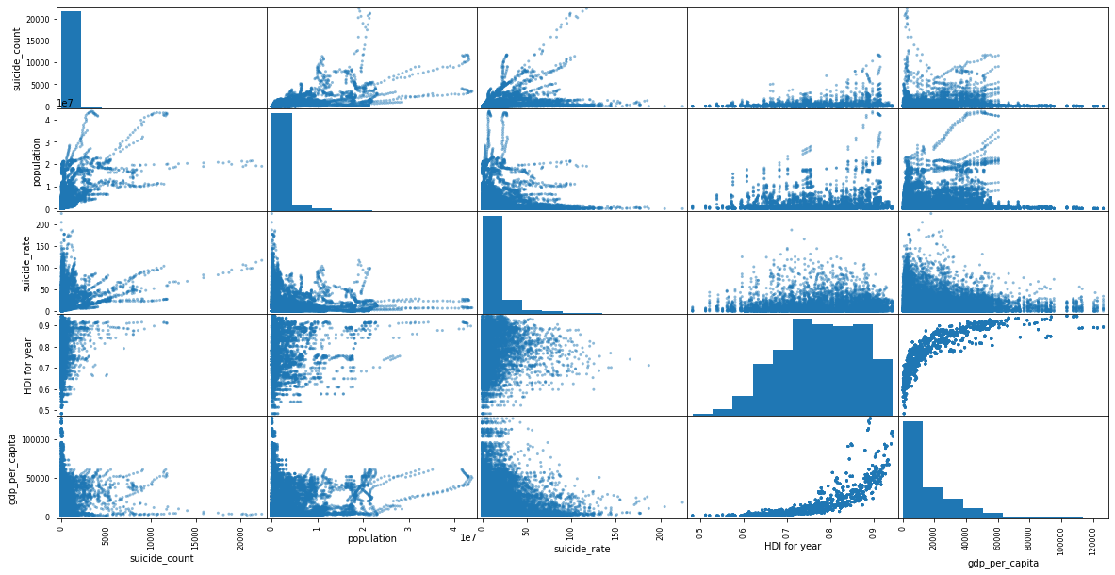
DATASET SCATTER MATRIX
From the scatter matrix, it is obvious that the data has outlier & these are addressed during data preprocessing.

Slide 8
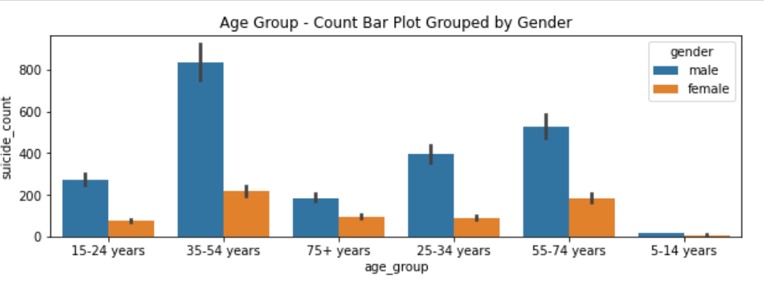
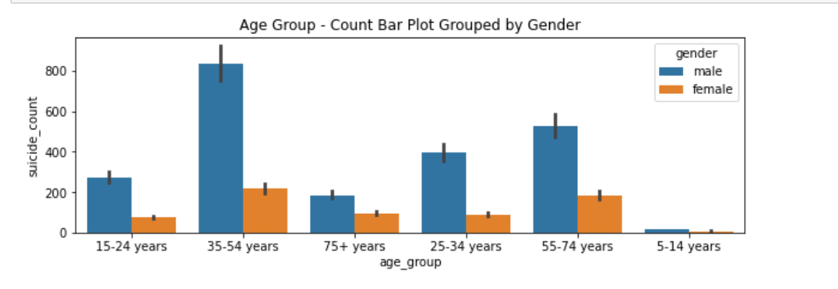
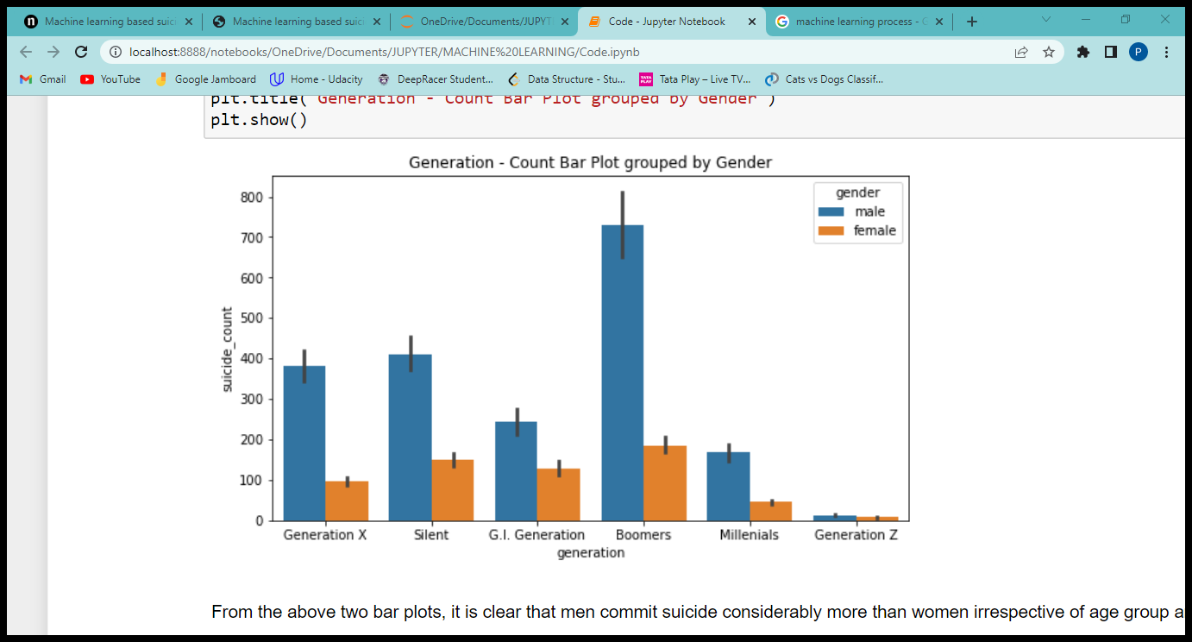
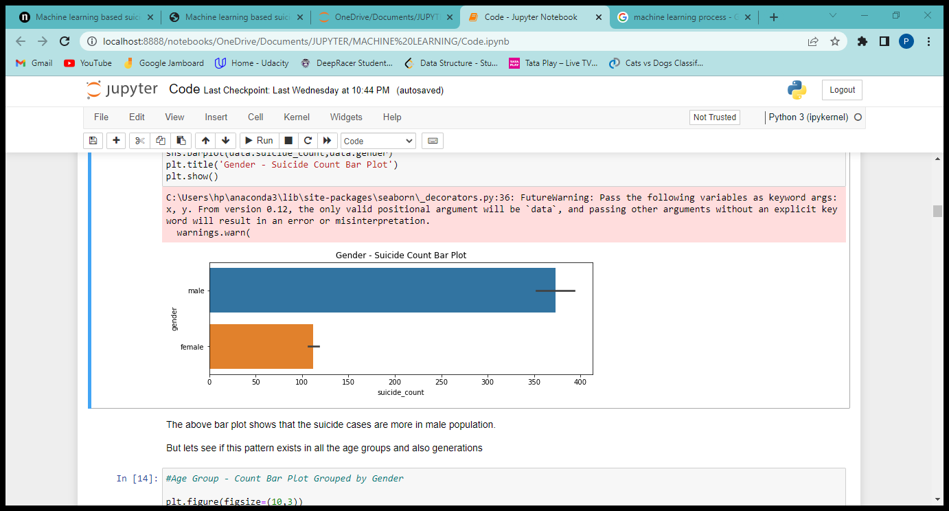
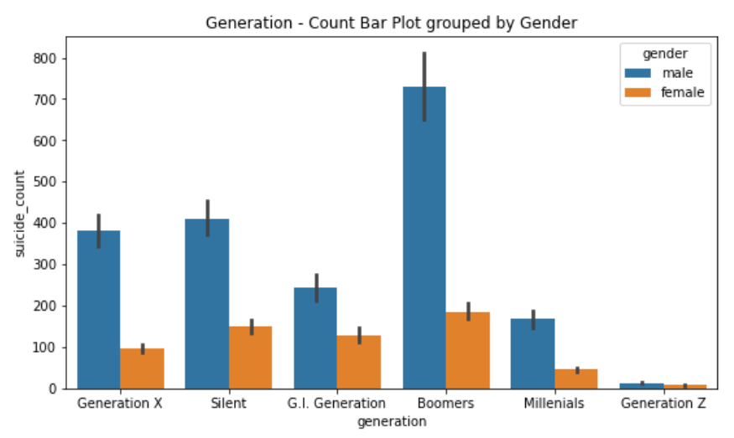
DATA VISUALIZATION

Slide 9
DATA PREPROCESSING
Null value check HDI for year has 19456 null values.
Duplicate column - country-year which is a combination of values in country & year columns.
The numerical features of the dataset are scaled using RobustScalar.
The categorical features are encoded by LabelEncoder.
count of suicides, population, suicide rate, gdp_for_year, gdp_per_capita.
country, sex, age group, generation

Slide 10
TRAINING MODELS
The supervised machine learning models trained on this dataset are:
K-Nearest Neighbors Regression
Linear Regression
DecisionTree
Random Forest
Gradient Boosted Regression
Multilayer Perceptron Regression
XGBoost Regression
Bagging Regression
Ensemble SuperLearner

Slide 11
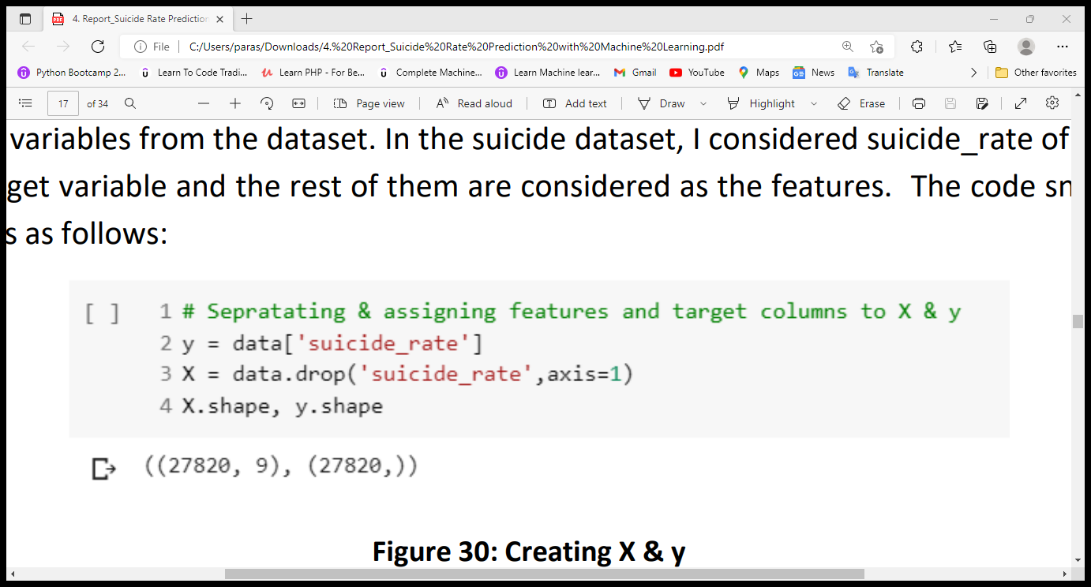
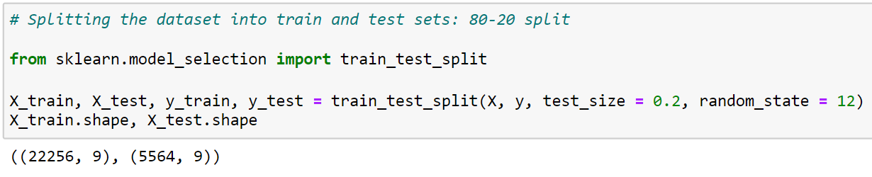
SPLITTING THE DATA
The input and target variables of train data are denoted by X_train & y_train and for test data, X_test & y_test respectively. After splitting, the training dataset has 22,256 samples and the test dataset has 5,564 samples. Now, the supervised machine learning models are trained with the training dataset in the next step.

Slide 12
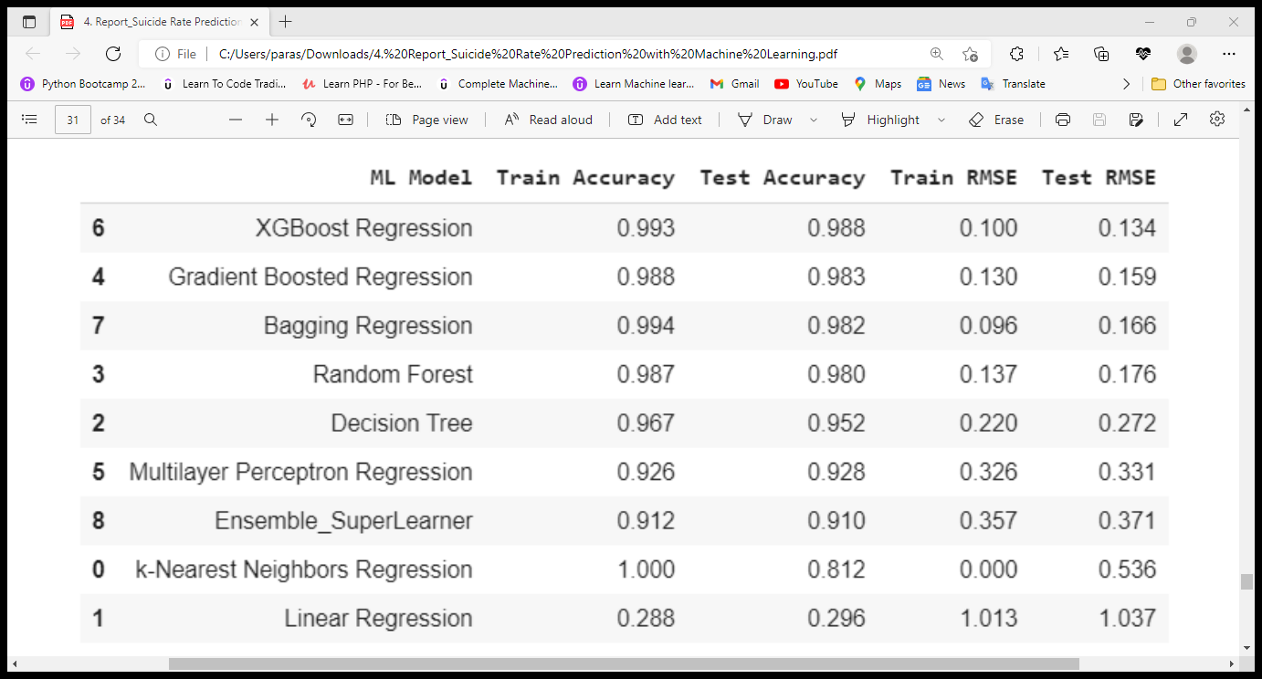
MODEL RESULTS
Among all the trained modesl, XGBoost performance is better. It is understandable because this model is very good in execution Speed & model performance.

Slide 13
CONCLUSION
The final take away from this project is the working of different machine learning models on a dataset and understanding their parameters. Creating this project helped us to learn a lot about the parameters of the models, how to tune them and how they affect the model performance. The final conclusion on the suicide dataset are that the irrespective of age group and generation, male population are more prone to commit suicide than female.

